Slide 1
Proof by Contradiction
and as applied to Prim’s Algorithm

Slide 2
Proof by Contradiction
We wish to prove a proposition, P.
Assume the opposite, ¬P (= not P)
By applying axioms or other known proofs, show that ¬P results in a contradiction.
Hence P must be true.

Slide 3
Proof by Contradiction
There is no smallest rational number

Slide 4
Proof by Contradiction
Proposition, P: There is no smallest rational number
Assume, ¬P: There is a smallest rational number.
Define the smallest rational number as r = a/b
Construct r’ = a / (2b)
But r’ < r
So ¬P results in a contradiction.
QED

Slide 5
Proof by Contradiction
There are an infinite number of primes.

Slide 6
Proof by Contradiction
Proposition, P: There are an infinite number of primes
Assume, ¬P: There are a finite number of primes.
Construct a finite set of prime numbers: {p₁ , p₂ , p₃ , p₄ , p₅……, p_{n}}
Consider an integer, N = p₁ x p₂ x p₃ x p₄ x p₅…… x p_{n} + 1
Under the assumption ¬P, N is not prime and therefore has a prime factor: p_{i}
So, N / p_{i} = (p₁ x p₂ x p₃ x p₄ x p₅…… x p_{n}) / p_{i} + 1 / p_{i}
But, 1 / p_{i} is not an integer, so N has no prime factor, and is therefore a prime
So ¬P results in a contradiction.
QED

Slide 7
Proof by Contradiction
If x² is even, then x must be even

Slide 8
Proof by Contradiction
Proposition, P: If x² is even, then x must be even
Assume, ¬P: If x² is even, then x must be odd
Let x = 2n + 1
x² = 4n² + 4n + 1
But this means x² is odd (because x² = 4n² + 4n + 1)
So ¬P results in a contradiction.
QED

Slide 9
Proof by Contradiction
sqrt(2) is an irrational number

Slide 10
Proof by Contradiction
Proposition, P: sqrt(2) is an irrational number
Assume, ¬P: sqrt(2) is a rational number
Let sqrt(2) = a / b, where a/b cannot be simplified further
2 = a² / b²
a² = 2b²
Since a² is even, a is even (a = 2k)
(2k)² = 2b²
4k² = 2b²
b² = 2k²
Since b² is even, b must also be even
But both a and b can’t be even,
otherwise a/b can be simplified further.
So ¬P results in a contradiction.
QED

Slide 11
Prim’s Proof by Contradiction

Slide 12
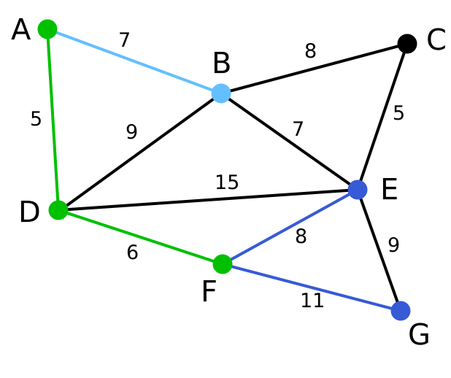
Prim’s Proof by Contradiction

Slide 13
Prim’s Proof by Contradiction

Slide 14
Prim’s Proof by Contradiction

Slide 15
Prim’s Proof by Contradiction

Slide 16
Prim’s Proof by Contradiction

Slide 17
Prim’s Proof by Contradiction

Slide 18
Prim’s algorithm picks the lowest weighted edge that connects the 2 spanning trees...

Slide 19
Prim’s algorithm picks the lowest weighted edge that connects the 2 spanning trees...

Slide 20
But let’s assume this does NOT produce the minimal spanning tree… and that selecting ANOTHER edge would.

Slide 21
Let’s pick this one for example

Slide 22
Let’s pick this one for example
This is a spanning tree

Slide 23
Let’s pick this one for example
This is a spanning tree
This is a spanning tree

Slide 24
So this edge that connects the 2 spanning trees must also now produce a minimal spanning tree.
This is a spanning tree
This is a spanning tree

Slide 25
So this edge that connects the 2 spanning trees must also now produce a minimal spanning tree.
This is a spanning tree
This is a spanning tree

Slide 26
A minimal spanning tree across the entire graph
This is a spanning tree
This is a spanning tree

Slide 27
Let’s now form a cycle by selecting the lowest weight edge connecting the 2 sub-spanning trees
This is a spanning tree
This is a spanning tree

Slide 28
Let’s now form a cycle by selecting the lowest weight edge connecting the 2 sub-spanning trees
This is a spanning tree
This is a spanning tree

Slide 29
No longer a tree… because there is a cycle
This is a spanning tree
This is a spanning tree

Slide 30
Let’s remove the first edge
This is a spanning tree
This is a spanning tree

Slide 31
Let’s remove the first edge
This is a spanning tree
This is a spanning tree

Slide 32
We have another spanning tree
This is a spanning tree
This is a spanning tree

Slide 33
Let’s compare the weights...
This is a spanning tree
This is a spanning tree

Slide 34
Let’s compare the weights...
8
This is a spanning tree
This is a spanning tree

Slide 35
Let’s compare the weights...
This is a spanning tree
6
This is a spanning tree

Slide 36
Let’s compare the weights...
8
This is a spanning tree
6
This is a spanning tree

Slide 37
We have just found a spanning tree that is lower in total weight that the “minimal spanning tree”!
This is a spanning tree
6
This is a spanning tree

Slide 38
This is a contradiction!
This is a spanning tree
6
This is a spanning tree

Slide 39
Hence Prim’s algorithm selecting the lowest connected weight must be correct.
This is a spanning tree
6
This is a spanning tree

Slide 40
Proving the correctness of Prim’s algorithm
Proposition, P: Prim’s algorithm generates tree T, the MST of a graph G
Assume, ¬P: There is a tree T* which is the MST of graph G, where T* ≠ T

Slide 41
Proving the correctness of Prim’s algorithm
Proposition, P: Prim’s algorithm generates tree T, the MST of a graph G
Assume, ¬P: There is a tree T* which is the MST of graph G, where T* ≠ T
Let the edge (u, v) be in T but not in T*.
When (u, v) was added to T by Prim’s algorithm, it was the minimum edge crossing from the set of vertices, S, that had already been added to T, to the set of vertices, V – S, that had not been added to T.
Let (x, y) be an edge on the path from u to v in T* such that x is in S and y is in V – S.
Form a new tree, T**, by adding (u, v) to T* and removing (x, y) from T*.
But T** has a lower weight than T*, thus T* could not be the MST of G.
So ¬P results in a contradiction.
QED

Slide 42
S
V - S
(x, y)
y
x
u
(u, v)
v

